Slide 1

Roster Processing
For MOAA Chapter Leaders

Slide 2
Why is annual roster submission important?
$$$ For Your Chapter
  A $250 retention incentive will be awarded to those chapters that retain 95% or more of their chapter membership as determined by national MOAA from the roster submissions. To be eligible, your chapter must have met the previous year’s submission deadline to compare with the current year’s roster
  A $50 incentive will be awarded to chapters who:
    Have a designated chapter legislative chair and/or liaison reported to MOAA at chapters@moaa.org;
    Have an EFT account established; (go to www.moaa.org/eft to set up)
    Submit their roster early by January 15.
  Chapters can still earn $25 by meeting the above criteria and January 31 deadline.
Database Accuracy
  Having accurate membership numbers for your chapter in our database will allow us to provide your chapter with accurate recruiting list. This will help your chapter target new members and promote chapter membership growth.
Power in Numbers
  Each and every chapter member strengthens our clout on the Hill. When you join a MOAA Chapter, you become part of a united front for the protection of your earned military benefits.

Slide 3
Roster Process Timeline
November
  Membership Chairs, Roster Contacts and other chapter officers should check their members’ MOAA National membership ID numbers, email addresses, phone numbers, etc. for accuracy.
  Report new chapter members that have been recruited since your previous roster submission if you have not done so already: https://fs20.formsite.com/moaaweb/2013ChapterRecruiting/secure_index.html
  Confirm membership status with individuals that have not paid their chapter dues. If a member has passed away or has moved out of the area, do not include them on your roster. Your chapter will not be penalized for lost members due to deaths or moves.
December
  Prepare your roster for submission in MS Excel spreadsheet format. Please use the online template as a starting point : http://www.moaa.org/uploadedFiles/MOAA_Main/Main_Menu/Chapter%20Roster%20Template.xls
  If you still have new members to report, you must enter their information into the online form above no later than December 31 in order to get recruitment credit. Be sure to include your new members on your roster.
January
  We will be accepting rosters during the entire month of January. You must submit your roster no later than January 31 to be considered for the $250 retention credit.
  Multiple submissions are not allowed. Please thoroughly check your roster for accuracy prior to sending.
  Send your roster by email to chapters@moaa.org

Slide 4
Roster Process Timeline (cont’d)
February
  Roster submission closes.
  MOAA Chapters staff will begin loading rosters into the database.
  Don’t stop recruiting! We won’t be actively entering newly recruited chapter members during the first quarter, but you can still enter them on the online form for recruitment credit: https://fs20.formsite.com/moaaweb/2013ChapterRecruiting/secure_index.html
  New 2016 chapter members will be entered in the database after April 1, the official beginning of the new recruiting year.
March
  Once the staff has completed loading rosters, we will begin the retention reporting process to determine which chapters have qualified. Eligible chapters will be notified and receive their monetary awards by EFT.
  The new Recruiting lists and updated rosters will be pulled from the database and emailed securely to chapter Presidents and Membership Chairs.
April
  Chapter Recruiting officially starts, using the new roster as a growth baseline. Any members reported online during the first quarter will be entered and tracked for recruitment credit.
  Chapters will have fresh recruiting lists in hand and are encouraged to recruit new members to grow their chapter.

Slide 5
Preparing Your Roster
If starting from scratch, use the provided Roster Template as your guide: http://www.moaa.org/uploadedFiles/Content/Chapters_and_Councils/Council_and_Chapter_Management/Policy_and_Procedure_Guide_Appendix/Chapter%20Roster%20Template.xls
Or, Start with the previous year’s roster confirmation file, sent from MOAA National to Chapter Presidents and Membership Chairs this past March
Add records of newly recruited members
  Provide as much information as you can according to the roster template.
  MOAA National staff can manually work around gaps in data, but more information provided up front means a quicker turnaround for all chapters to receive fresh rosters and recruiting lists for the upcoming recruiting season.
Remove records of individuals who:
  No longer belong to the chapter due to a lapse in membership dues payment
  Moved out of the area
  Have passed away
  *note: Moves and deaths do not count against your chapter’s retention score

Slide 6
Preparing Your Roster (cont’d)
Slide 8 has an example of the required format for roster submission. The column categories in bold are the most important for accuracy. There are 8 columns on the template that the database requires for processing, but are not necessary for you to fill in. They are:
Column B – Prefix
Column F – Suffix
Column L – Branch Component
Column N – SSN
Column R – Bday
Column T – Gender
Column V - Spouse Mid Initial
Column W – Spouse Bday
Do not worry about filling in these columns, but please do not delete them from
your spreadsheet. The remaining columns should be completed to the best of
your ability. Columns like A – MOAA ID# and Q – Email address are especially
important because they act as identifiers in the database and prevent duplicate
records from being created.

Slide 7
Preparing Your Roster (cont’d)
Information to Leave Out
Chapter Officer Positions – we don’t need to you to label chapter officer positions on your roster. Everyone should have “MEMB” listed under column S for chapter position
Spouses of Active members – the only spouses that should be on your roster as members are surviving spouses. Couples cannot be counted as two individual members unless they are both current, former or retired military officers.
Honorary Members – members of your chapter who are not eligible for MOAA membership but have been awarded an honorary membership by your chapter should not be included. MOAA Membership requirements can be found here: http://www.moaa.org/main_article.aspx?id=990
Punctuation - note on the next slide that all periods and commas have been removed from the member information. If you can help it, please enter your data without periods, commas, etc.

Slide 8
 | A | B | C | D | E | F | G | H | I | J
 | ID | Pre | Last | First | Mid | Suf | Addr | City | St | Zip
 | MOAA Membership # | Mr, Mrs, Dr, etc. | Last Name | First Name | Middle Initial (no period) | Jr, III, Esq, etc. | Street Address | City | State | 5 digit zip code
 | 1234567 |  | Wright | William | B |  | 201 N Washington St | Alexandria | VA | 22314
 | K | L | M | N | O | P | Q | R | S
 | Rank | Comp | Serv | SSN | Phone | MAS | Email | Bday | Pos
 | Rank abbreviation | Branch component (reserve, nat’l guard) | Branch of Service | Social security # (do not include) | Phone number (do not include dashes) | Military address status (ACT, FMR or RET) | Email address | Date of birth | Position in chapter
 | COL | USA | USA |  | 8002346622 | RET | chapters@moaa.org | MM/DD/YYYY | MEMB
 | T | U | V | W
 | Gender | SpFName | SpMInit | SpBDay
 | M or F | Spouse first name | Spouse middle initial | Spouse date of birth
 | M | Barbara | A | MM/DD/YYYY

Slide 9
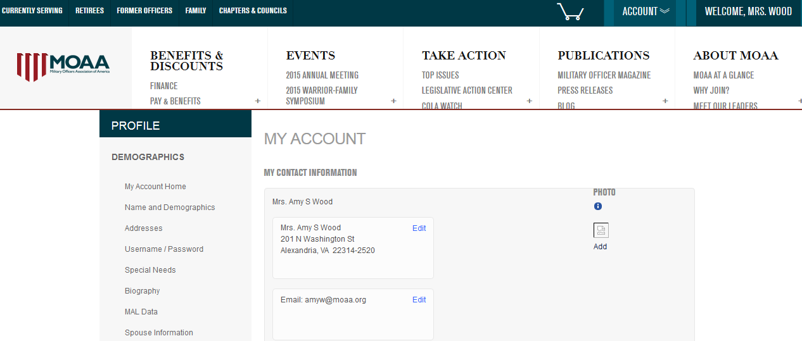
Chapter Member Info Updates
Roster processing is meant to serve as an accurate accounting for chapter membership. The update process will fill in missing information on an individual’s member record, but it will not replace existing information with new information. For example, if we have a blank email record for Barry Wright and the roster submission has chapters@moaa.org in column Q listed for his email, the program will add his email to the record. If we already have another email on file, no update will be made. Therefore, the roster process cannot be treated as an information update. All address, email, rank/service updates must be made through the MSC at 1-800-234-6622, msc@moaa.org or online at www.moaa.org:

Slide 10
Thank You!
We realize that your time is valuable and that chapter officers are volunteers. Your efforts are appreciated! We hope that this information has helped prepare you for the upcoming roster submission season. Please feel free to contact us at chapters@moaa.org with any questions.

